Slide 1
Rossby waves in the ocean
Stephan Juricke 20.01.2022

Slide 2
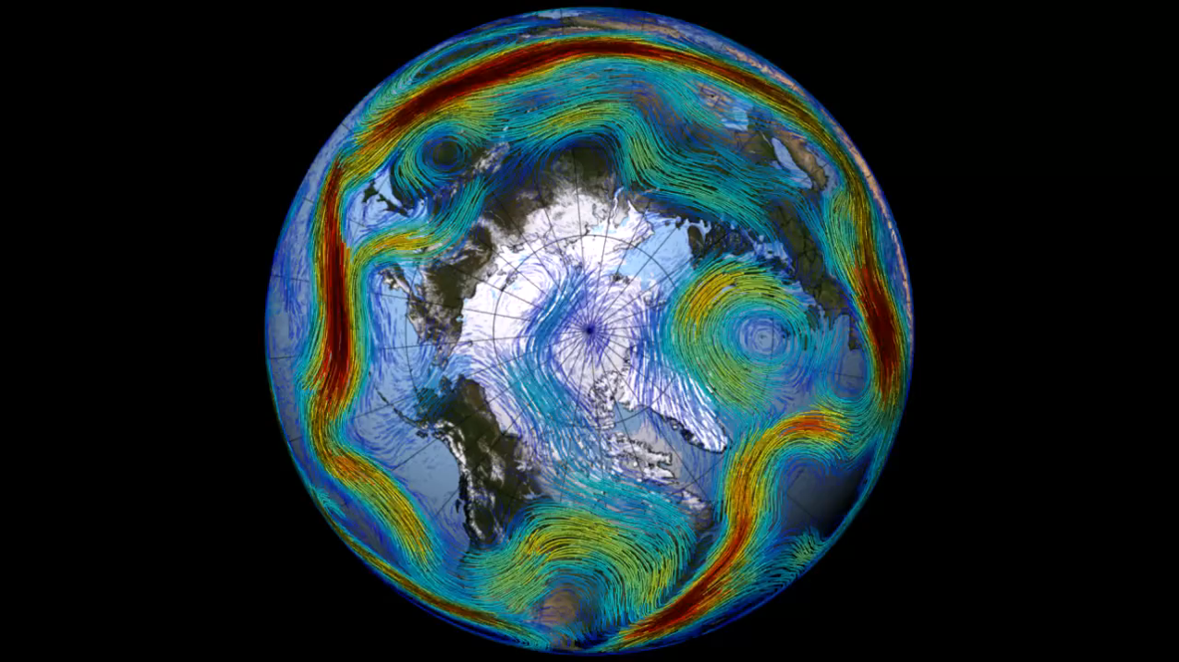
Example: Rossby waves in the atmosphere
NASA's Goddard Space Flight Center
https://oceanservice.noaa.gov/facts/rossby-wave.html
Notes:
precip change vor allem convective; double ITCZ??

Slide 3
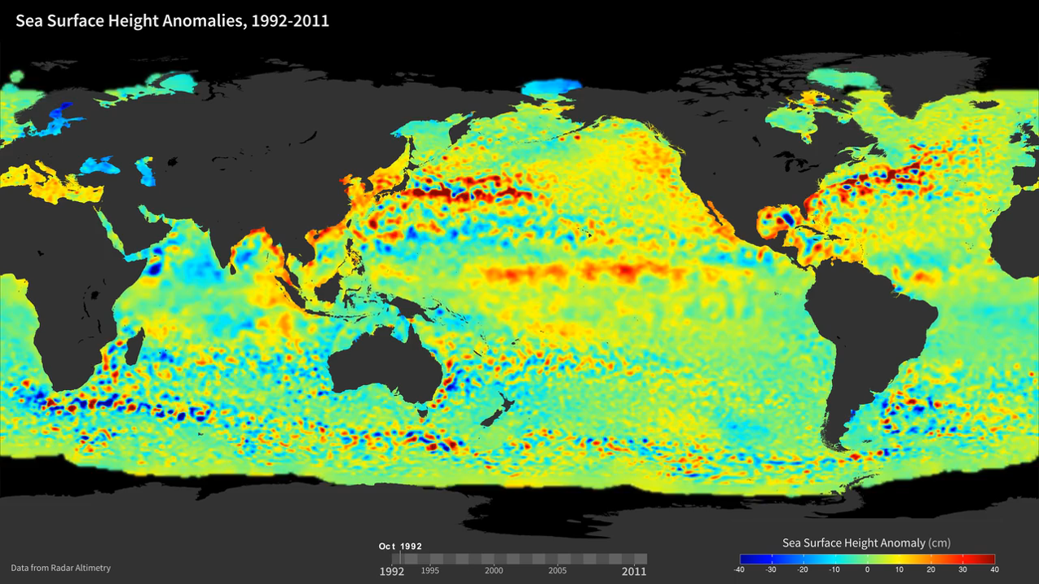
Example: Rossby waves in the ocean
https://svs.gsfc.nasa.gov/30502
Notes:
precip change vor allem convective; double ITCZ??

Slide 4
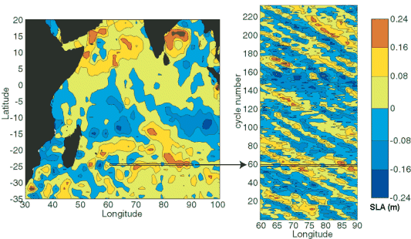
Example: Rossby waves in the ocean
(Credits Southampton Oceanography Center) https://www.aviso.altimetry.fr/en/news/image-of-the-month/2002/may-2002-planetary-waves-small-amplitudes-large-effects.html
Notes:
precip change vor allem convective; double ITCZ??

Slide 5
Short definition
Large scale waves in the ocean, communicating anomalies across ocean basins
Triggered by large scale (wind) anomalies
Transport momentum and energy
Important for teleconnection patterns and (potentially) long term predictability
Intrinsic phase speed is westward
Notes:
precip change vor allem convective; double ITCZ??

Slide 6
Background setup
Flow on a rotating sphere
Can be explained by absolute vorticity conservation (angular momentum conservation)
We will consider only barotropic case with constant water height, i.e. uniform vertical structure (well mixed)
Need several simplifications for various situations, but general concept remains the same
Notes:
precip change vor allem convective; double ITCZ??

Slide 7
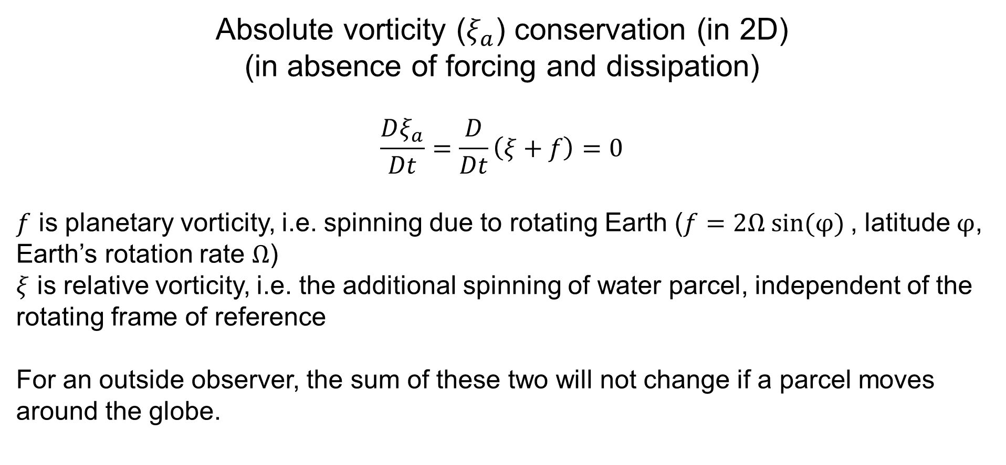
Background setup
Absolute vorticity ($ξ_{a}$) conservation (in 2D) (in absence of forcing and dissipation)
$$\frac{Dξ_{a}}{Dt}=\frac{D}{Dt}\left(ξ+f\right)=0$$
$f$ is planetary vorticity, i.e. spinning due to rotating Earth ($f=2Ω sin(φ)$, latitude $φ$, Earth’s rotation rate $Ω$)
$ξ$ is relative vorticity, i.e. the additional spinning of water parcel, independent of the rotating frame of reference
For an outside observer, the sum of these two will not change if a parcel moves around the globe.
Notes:
precip change vor allem convective; double ITCZ??

Slide 8


Background setup
$$\frac{Dξ_{a}}{Dt}=\frac{D}{Dt}\left(ξ+f\right)=0$$
View onto equator
View onto North Pole
Notes:
precip change vor allem convective; double ITCZ??

Slide 9


Barotropic Rossby wave
Westward
$$ξ<0$$
Latitude
$$ξ>0$$
Longitude
Notes:
precip change vor allem convective; double ITCZ??

Slide 10
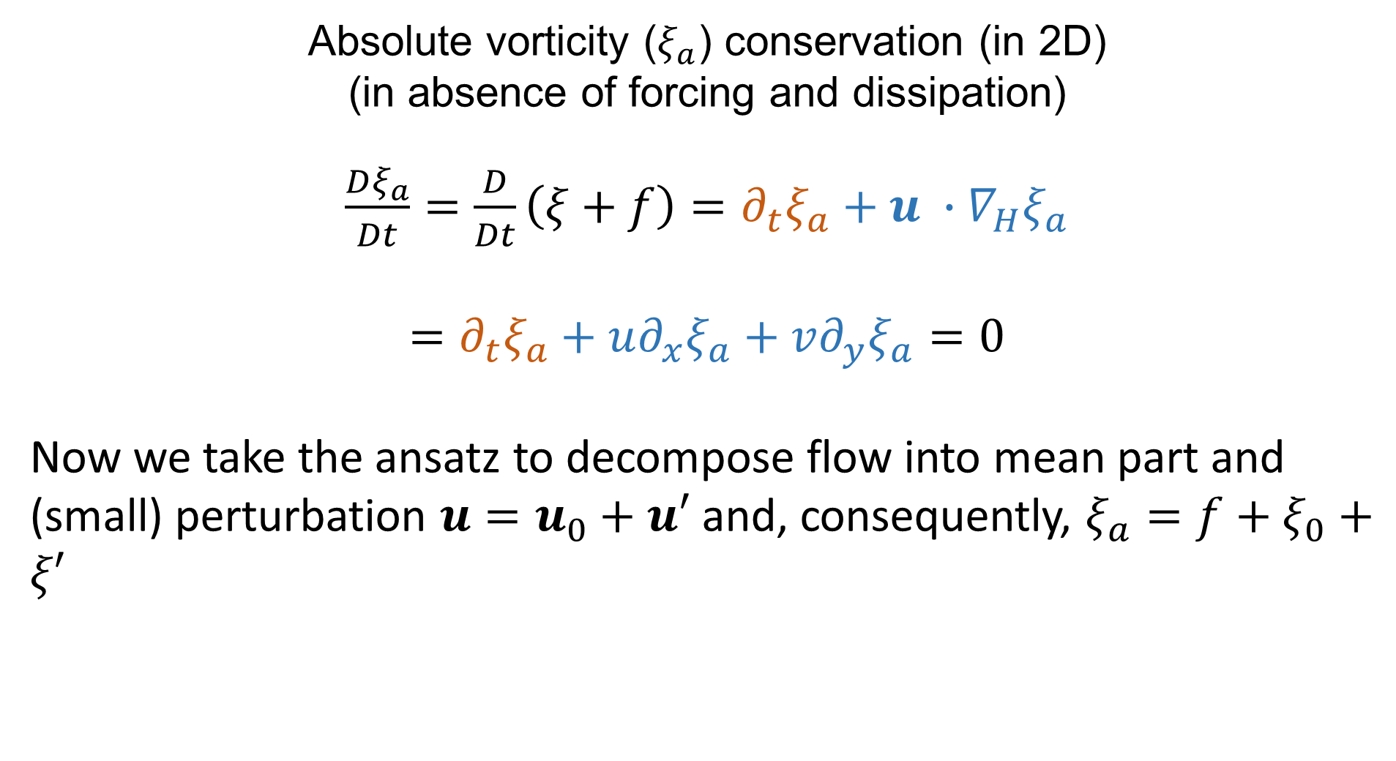
Derivation
Absolute vorticity ($ξ_{a}$) conservation (in 2D) (in absence of forcing and dissipation)
$\frac{Dξ_{a}}{Dt}=\frac{D}{Dt}\left(ξ+f\right)=∂_{t}ξ_{a}+u ∙∇_{H}ξ_{a}$
$$=∂_{t}ξ_{a}+u∂_{x}ξ_{a}+v∂_{y}ξ_{a}=0$$
Now we take the ansatz to decompose flow into mean part and (small) perturbation $u=u_{0}+u′$ and, consequently, $ξ_{a}=f+ξ_{0}+ξ′$
Notes:
precip change vor allem convective; double ITCZ??

Slide 11
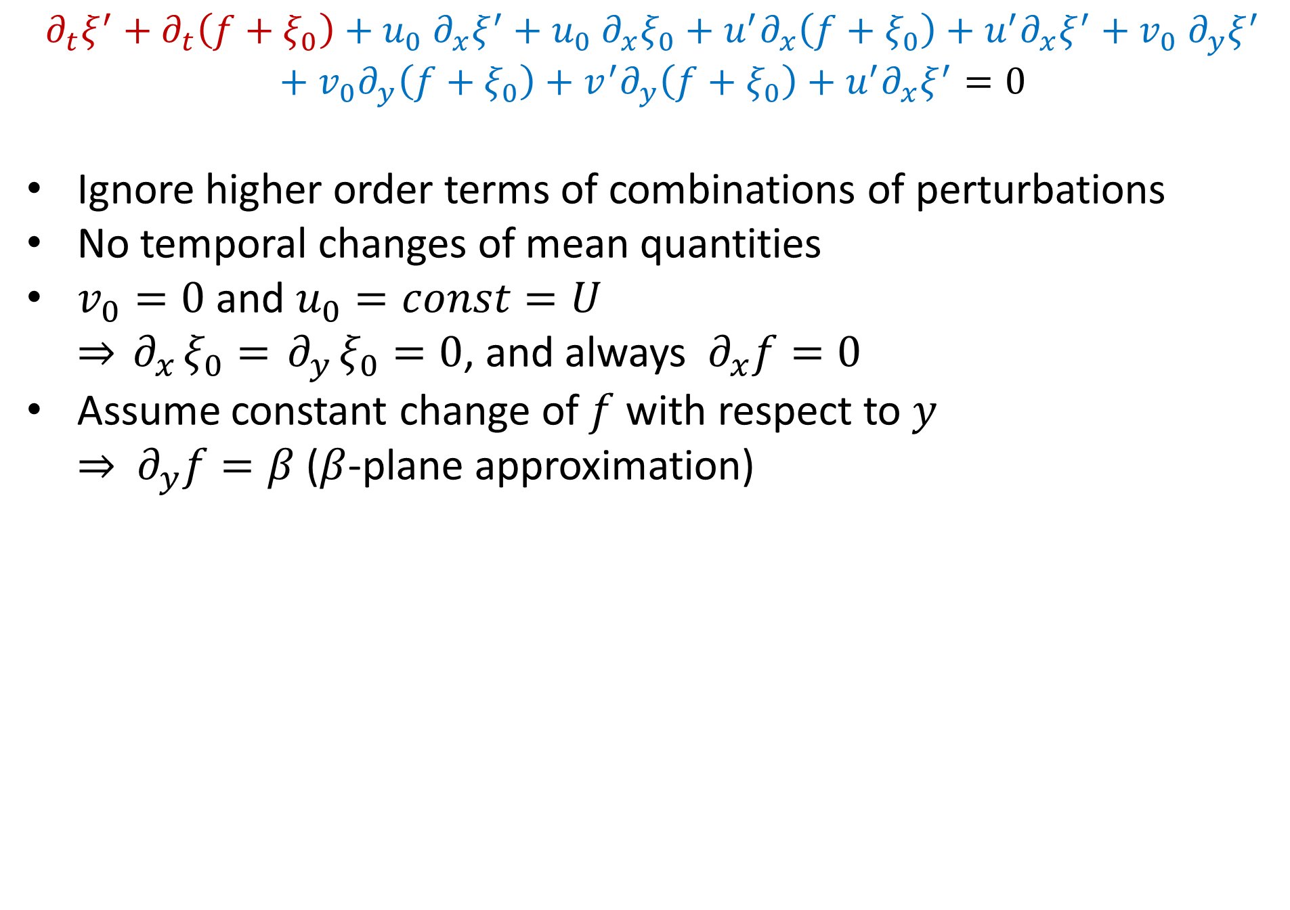



Derivation
$$U$$
$$U$$
$$∂_{t}ξ^{′}+∂_{t}\left(f+ξ_{0}\right)+u_{0}{ ∂}_{x}ξ^{′}+u_{0}{ ∂}_{x}ξ_{0}+u^{′}∂_{x}\left(f+ξ_{0}\right)+u^{′}∂_{x}ξ^{′}+v_{0}{ ∂}_{y}ξ^{′}+v_{0}∂_{y}\left(f+ξ_{0}\right)+v^{′}∂_{y}\left(f+ξ_{0}\right)+u^{′}∂_{x}ξ^{′}=0$$
Ignore higher order terms of combinations of perturbations
No temporal changes of mean quantities
$v_{0}=0$ and $u_{0}=const=U$ $⇒{ ∂}_{x}ξ_{0}={ ∂}_{y}ξ_{0}=0$, and always ${ ∂}_{x}f=0$
Assume constant change of $f$ with respect to $y$ $⇒$ ${ ∂}_{y}f=β$ ($β$-plane approximation)
$$β$$
Notes:
precip change vor allem convective; double ITCZ??

Slide 12
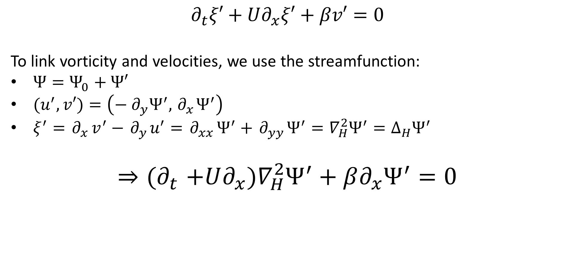
Derivation
$$∂_{t}ξ′+U∂_{x}ξ′+βv′=0$$
To link vorticity and velocities, we use the streamfunction:
$Ψ=Ψ_{0}+Ψ′$
$(u^{′},v′)=\left(−{ ∂}_{y}Ψ^{′},{ ∂}_{x}Ψ^{′}\right)$
$ξ^{′}={ ∂}_{x}v^{′}−{ ∂}_{y}u^{′}={ ∂}_{xx}Ψ^{′}+{ ∂}_{yy}Ψ^{′}=∇_{H}^{2}Ψ^{′}=Δ_{H}Ψ^{′}$
$${⇒(∂}_{t}+U∂_{x})∇_{H}^{2}Ψ^{′}+β∂_{x}Ψ^{′}=0$$
Notes:
precip change vor allem convective; double ITCZ??

Slide 13
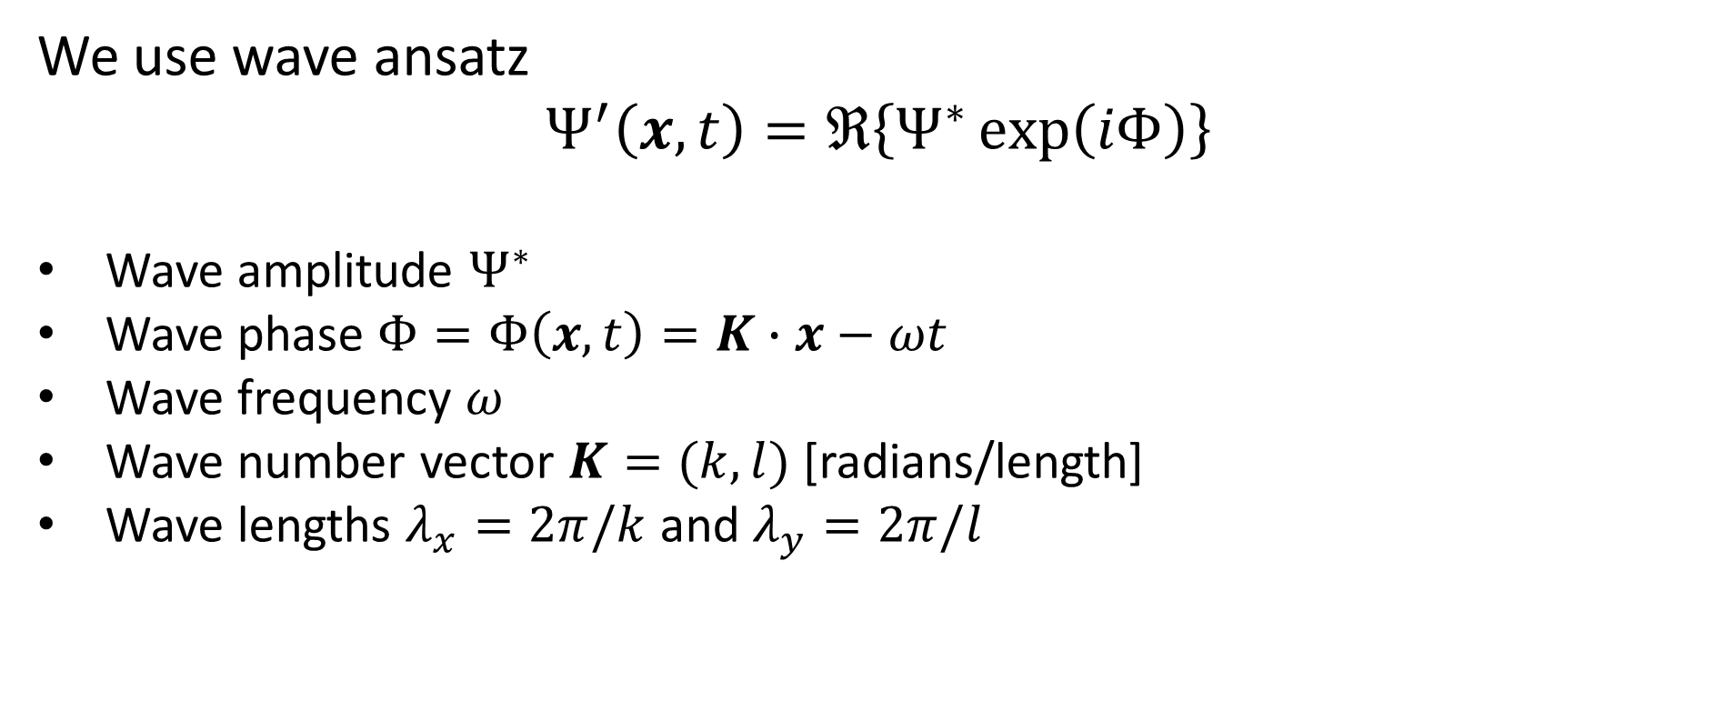
Derivation
We use wave ansatz
$$Ψ^{′}\left(x,t\right)=ℜ\left\{Ψ^{∗}\exp\left(iΦ\right)\right\}$$
Wave amplitude $Ψ^{∗}$
Wave phase $Φ=Φ\left(x,t\right)=K∙x−ωt$
Wave frequency $ω$
Wave number vector $K=(k,l)$ [radians/length]
Wave lengths $λ_{x}=2π/k$ and $λ_{y}=2π/l$
Notes:
precip change vor allem convective; double ITCZ??

Slide 14
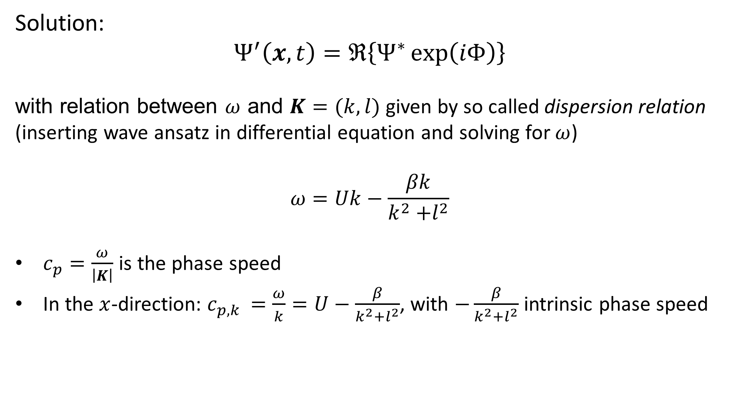
Derivation
Solution:
$$Ψ^{′}\left(x,t\right)=ℜ\left\{Ψ^{∗}\exp\left(iΦ\right)\right\}$$
with relation between $ω$ and $K=(k,l)$ given by so called dispersion relation (inserting wave ansatz in differential equation and solving for $ω$)
$$ω=Uk−\frac{βk}{k^{2}{+l}^{2}}$$
$c_{p}=\frac{ω}{\left|K\right|}$ is the phase speed
In the $x$-direction: $c_{p,k }=\frac{ω}{k}=U−\frac{β}{k^{2}{+l}^{2}}$, with $−\frac{β}{k^{2}{+l}^{2}}$ intrinsic phase speed
Notes:
precip change vor allem convective; double ITCZ??

Slide 15
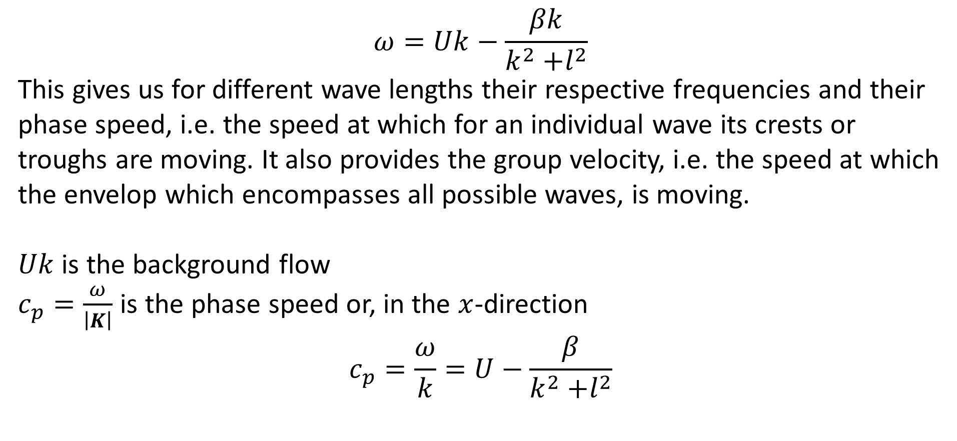
Derivation
$$ω=Uk−\frac{βk}{k^{2}{+l}^{2}}$$
This gives us for different wave lengths their respective frequencies and their phase speed, i.e. the speed at which for an individual wave its crests or troughs are moving. It also provides the group velocity, i.e. the speed at which the envelop which encompasses all possible waves, is moving.
$Uk$ is the background flow
$c_{p}=\frac{ω}{\left|K\right|}$ is the phase speed or, in the $x$-direction
$$c_{p}=\frac{ω}{k}=U−\frac{β}{k^{2}{+l}^{2}}$$
Notes:
precip change vor allem convective; double ITCZ??

Slide 16
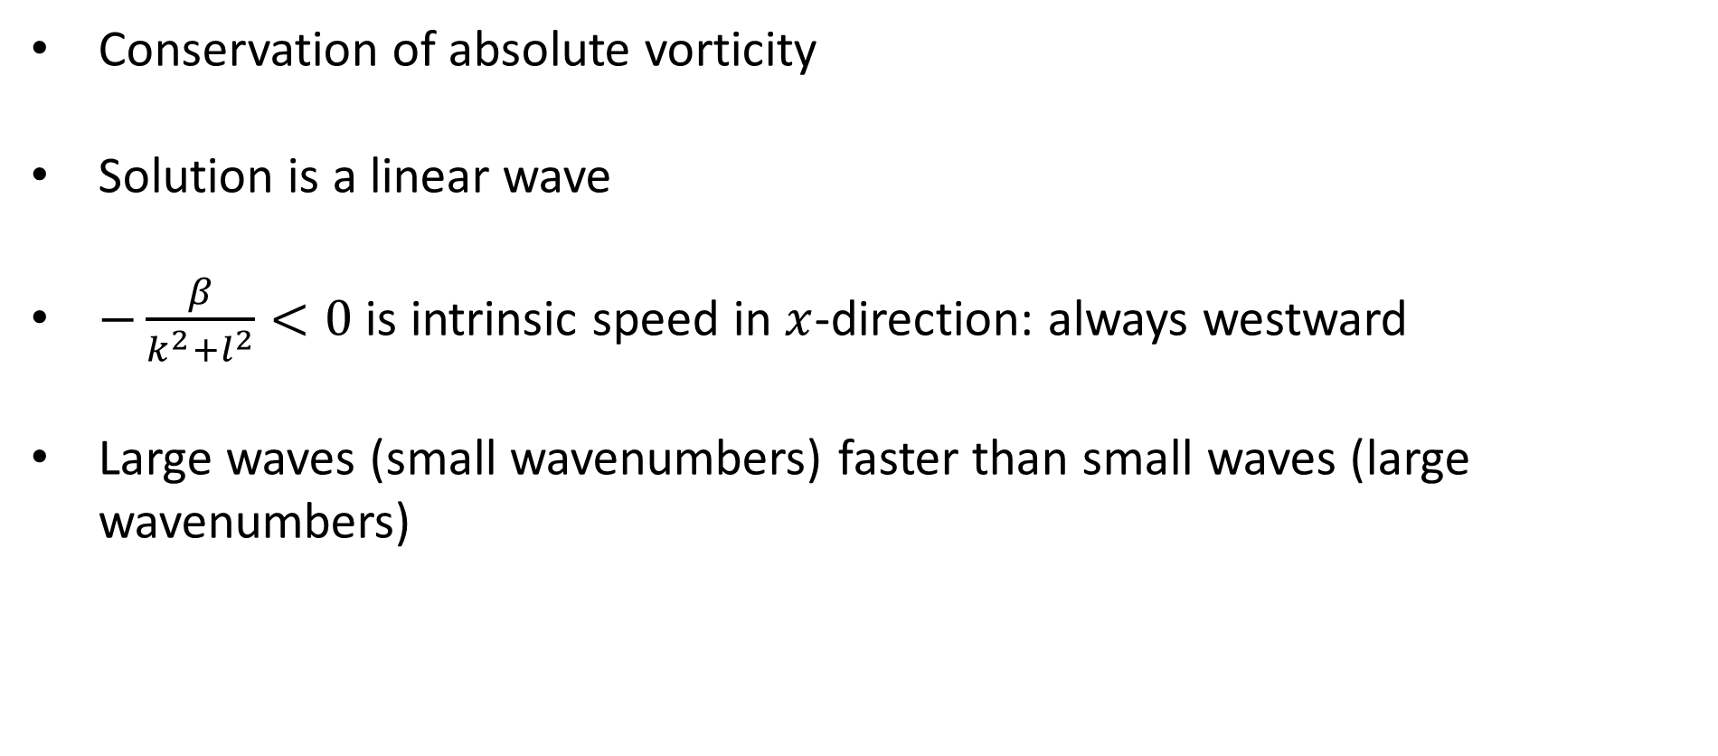
Summary
Conservation of absolute vorticity
Solution is a linear wave
$−\frac{β}{k^{2}{+l}^{2}}<0$ is intrinsic speed in $x$-direction: always westward
Large waves (small wavenumbers) faster than small waves (large wavenumbers)
Notes:
precip change vor allem convective; double ITCZ??

Slide 17
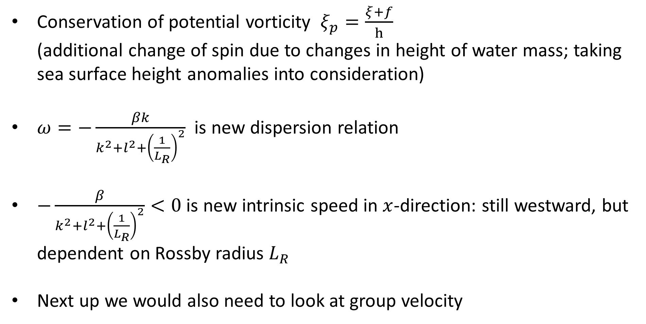
Outlook
Conservation of potential vorticity $ξ_{p}=\frac{ξ+f}{h}$ (additional change of spin due to changes in height of water mass; taking sea surface height anomalies into consideration)
$ω=−\frac{βk}{k^{2}{+l}^{2}+{\left(\frac{1}{L_{R}}\right)}^{2}}$ is new dispersion relation
$−\frac{β}{k^{2}{+l}^{2}+{\left(\frac{1}{L_{R}}\right)}^{2}}<0$ is new intrinsic speed in $x$-direction: still westward, but dependent on Rossby radius $L_{R}$
Next up we would also need to look at group velocity
Notes:
precip change vor allem convective; double ITCZ??

